Slide 1
CSCI 3907-80/CSCI 6444-10: Big Data and Analytics Summer 2021 Stephen H. Kaisler, D.Sc.
Lecture 1 – Introduction to Big Data

Slide 2
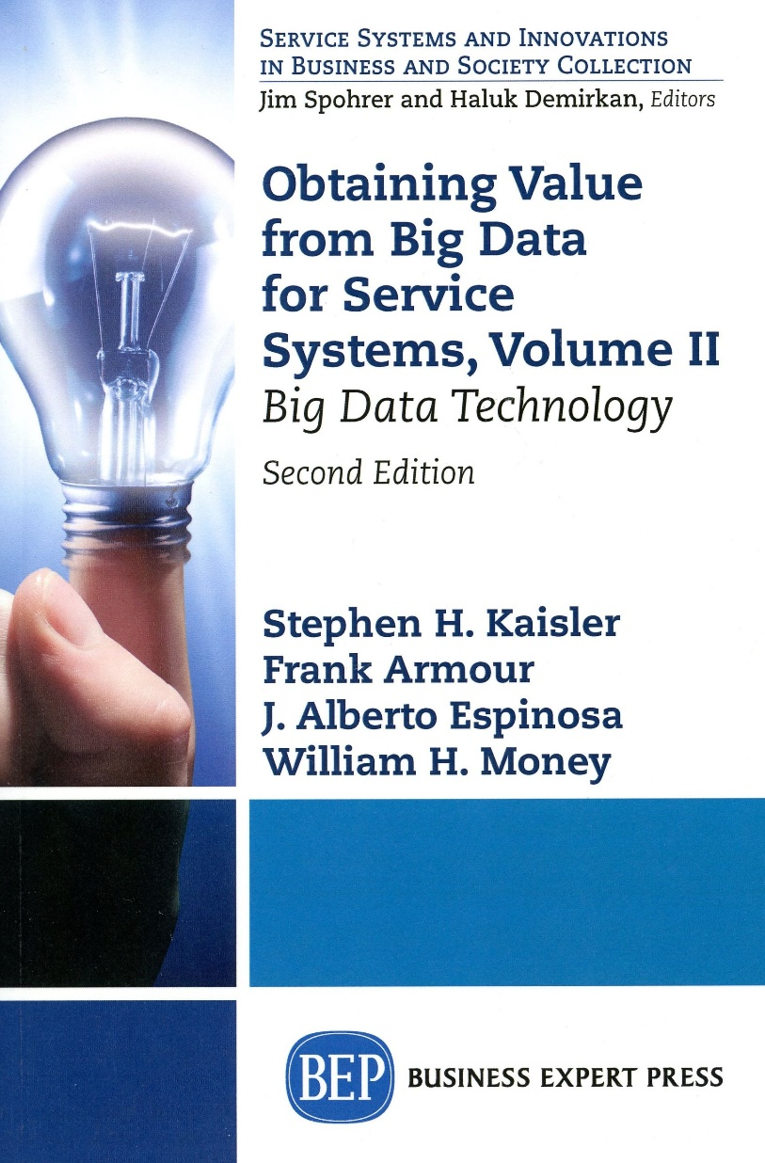
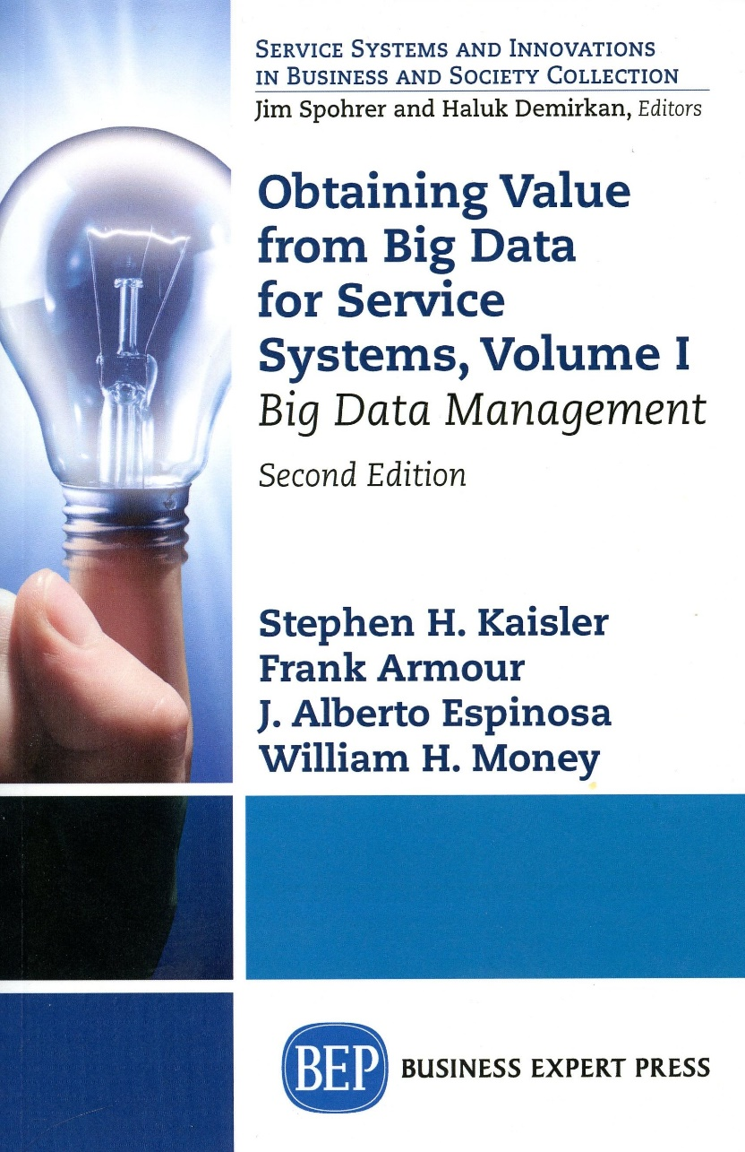
Recent Book – Two Volumes
Notes:
We wrote the First Edition, and then were asked to expand it to the Second Edition into two volumes.
This is meant for Middle Managers who need to understand the ideas.

Slide 3
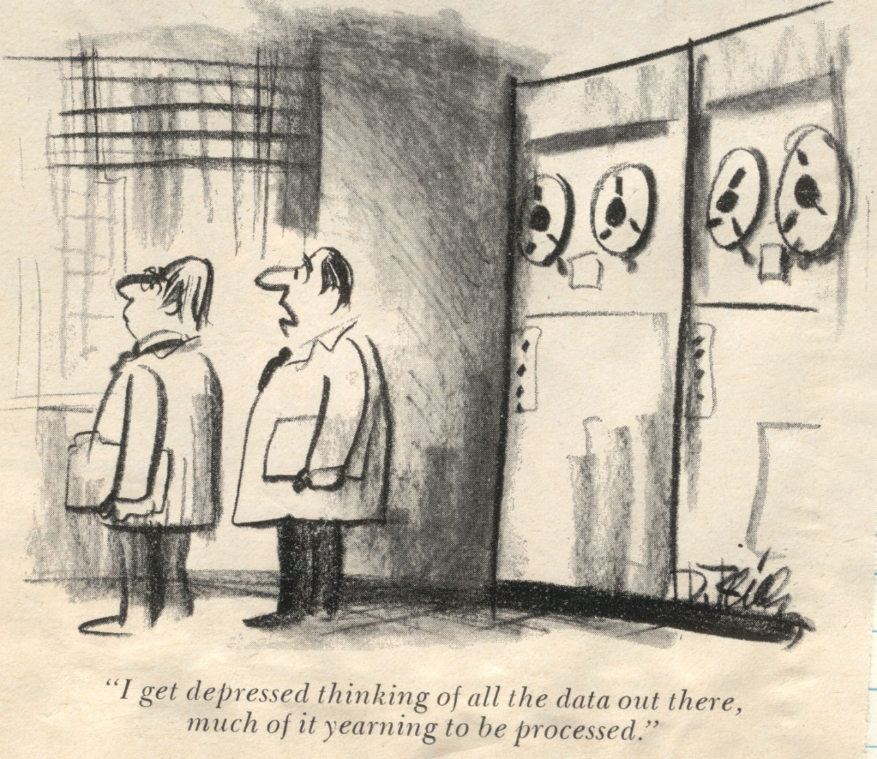
Big Data and Me and You
Notes:
You’ll find that I like cartoons to reinforce some ideas.

Slide 4
There's a Wealth of Data out there, but……….
Organizations have access to a wealth of information, but they can’t get value out of it because it is sitting in its most raw form or in a semistructured or unstructured format; and as a result, they don't even know whether it's worth keeping (or even able to keep it for that matter).
Did you know that :
80 percent of the world's information is unstructured.
Unstructured information is growing at 15 times the rate of structured information.
Raw computational power is growing at such an enormous rate that today's off-the-shelf commodity box is starting to display the power that a supercomputer showed half a decade ago.
Key Idea from the Web: Access to information has been democratized: it is (or should be) available for all.
- Understanding Big Data: Analytics for Enterprise Class Hadoop and Streaming Data, 2012
Intro-4
Notes:
So, Big Data has been around for quite awhile…
Approximately 40 years or so, although some people have claimed the term is more recent.
Lots of information abounds in lots of places.
The Alexandria Library in Egypt was one of the world’s greatest repositories until it was burned in the late BCs.
The Library of Congress is another great repository.
And, the British Library.

Slide 5
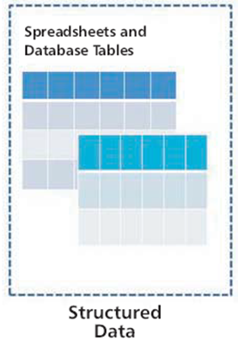
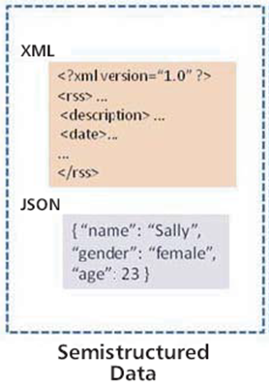
Types of Big Data
Structured:
Usually has a defined length and format
Ex: numbers, dates, strings
Probably accounts for about 20% of all the data out there
Usually stored in a file or a database (as records or tables)
Unstructured Data:
Data that does not follow a specific format
Accounts for the other 80% of data
Ex: documents, images, video, audio, sets of data
Semistructured Data:
Falls between the other two
May not conform to a fixed schema, but may be self-defining
Ex: RDF, XML, linked data
Notes:
So,
Amount of Semistructured Data <
Amount of Structured Data <
Amount of Unstructured Data
Just estimates, no exact figures,
But, as Estes Kefauver (R. IL) used to say (1969):
“A billion here and a billion there and then you are into real money”
So (updated):
“A few trillion bytes here and a few trillion bytes there, and soon you are into real big data”

Slide 6
Types of Data
Structured vs. Unstructured
Structured:
Usually has a defined length and format
Ex: numbers, dates, strings
Probably accounts for about 20% of all the data out there
Usually stored in a file or a database (as records or tables)
Unstructured Data:
Data that does not follow a specific format
Accounts for the other 80% of data
Ex: documents, images, video, audio, sets of data
Semistructured Data:
Falls between the other two
May not conform to a fixed schema, but may be self-defining
Ex: RDF, XML, linked data
Notes:
So,
Amount of Semistructured Data <
Amount of Structured Data <
Amount of Unstructured Data
Just estimates, no exact figures,
But, as Estes Kefauver (R. IL) used to say (1969):
“A billion here and a billion there and then you are into real money”
So (updated):
“A few trillion bytes here and a few trillion bytes there, and soon you are into real big data”

Slide 7
What is Big Data?
a,b,c,d,e
….
….
v,w,x,y,z
Few attributes (< 20 or so)
Lots of records (tens to hundreds of millions)
Attributes may have a wide range of values
Attributes often same type (numeric or alphanumeric)
Many attributes (hundreds to thousands)
Many records (but not tens of millions)
Attributes have mixed data types (possibly XML, RDF)
Attributes have varying value ranges
a,b,c,d,e,f,g,h,I,j,k…
a,b,c,d,e,f,g,h,I,j,k…
……
……
l,m,n,o,p,q,r,s,t,u,…
Some combination of the above
Both large width and large depth
Notes:
This applies to Structured and Semistructured Data.
This shows that you can get to big data in many different ways.
Now, an interesting question: With millions of records, what is the distribution of values of the attributes of the records?
That is, if many of the records vary very little in attribute values, how much is that contributing to your understanding of the phenomenon.
We will visit this idea of “value” of data and its contributions to decision-making several times in this course.
On the other hand, if you have thousands of records with lots of attributes with very diverse values, what does that contribute?
As a data scientist, you must “know” your data!
And, you must “know” your domain.

Slide 8
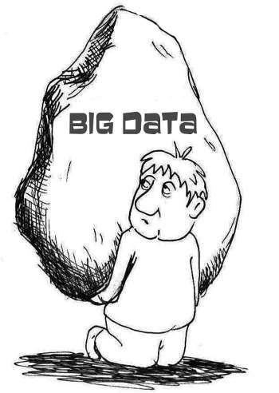
Big Data: A Definition
Big Data can be defined as the amount of data just beyond technology’s capability to store, manage and process efficiently.
Notes:
There are lots of definitions for Big Data.
This is ours because it captures the three challenges for Big Data.
We are going to talk about these throughout the semester.
An interesting term paper would be to research the definitions of Big Data and reconcile them.

Slide 9
Big Data: What is it?
The situation where our most difficult problem is not how to store the data, but how to process it in meaningful ways
It is estimated that 70-85% of all data is unstructured text, audio and images (and rising!)
In the past 50 years, the New York Times produced 3 billion words.
Twitter users produce 8 billion words – every single day
Most of it semistructured: Why??
*Source: Kalev Leetaru, University of Illinois
More data is not simply more data, but more data is different!
Notes:
What do we mean by “more data”?
The sheer volumetric quantity or the different types of data – multiple record formats, media formats, representational methods.

Slide 10
Big Data Is Evolutionary
A TByte size (10¹²) data warehouse used to be Big Data
Now, some data warehouses store tens of petabytes of data
And, a Chinese server stores 40 zettabytes of data
New analytical platforms have emerged to store and analyze Big Data
And, its creation and aggregation are accelerating,
Petabytes (10¹⁵) → Exabytes (10¹⁸) → Zettabytes (10²¹)
- Total created in 2010 would fill 75 billion 16 GByte iPads
- 1 Zettabyte = 1 Billion 1TB Disk Drives
Lots of Big Data is legacy data that has never been analyzed
1999: A Teradata customer created a 130 TB database
What did he do with it?
Ref: McKinsey Global Institute, Big Data: The Next Frontier for innovation, Competition, and Productivity, May 2011 and others
Notes:
When I was a DARPA Program Manager in Strategic Computing in the mid 1980s, we thought Big Data was Gigabytes
By 1990, it was thought to be Terabytes.
By late 1990s, it was Petabytes.
In 2005, DARPA ran a conference on Exabyte Computing
Now, we are on the verge of Zettabyte storage and processing.
In fact, there is a computing complex in China that stores over 40 Zbytes and is continuing to grow.
Teradata was a company that designs and builds database machines for large databases. (see www.Teradata.com)

Slide 11
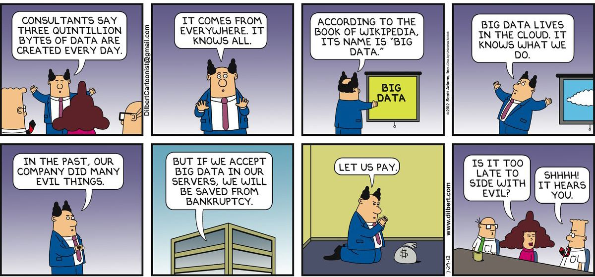
Dilbert on Big Data

Slide 12
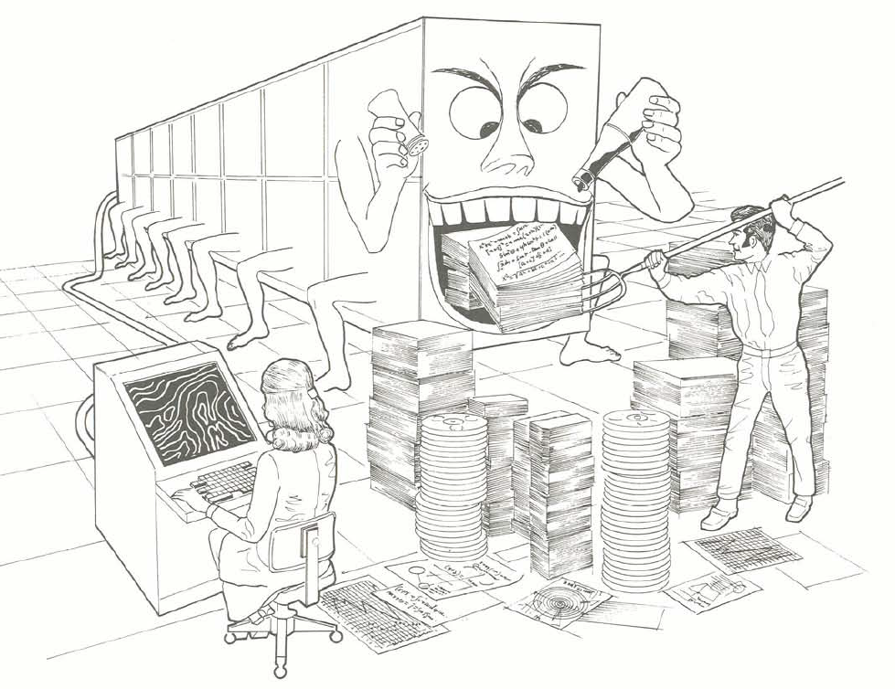
Can Processing Keep Up?
Ref: Burroughs Corp. 1974. Illiac IV (brochure)
Notes:
The Illiac IV was one of the first parallel processors funded by DARPA.
The amount of data continues to out grow our ability to process it, hence the need to find faster, larger computing systems.
At DARPA I managed several high performance computing projects – BBN Butterfly Parallel Processor, CMU/GE Warp Systolic Array Processor.
- I also managed a $10M procurement and distributed four Thinking Machines CM-200 parallel processors to Strategic Computing contractors.

Slide 13

Big Data: Where is it?
From the Cisco Visual Index Global Mobile Data Traffic Forecast Update, August 2020:
Global mobile traffic by 2021: 587E bytes
Global IP Traffic by 2022: 4.8 Zbytes
That is >125 x the traffic of 2011 – just ten years ago
Expect 921 million wearable devices by end of 2021
By end of 2021, 5% will be real-time mobile video
4.8 billion Internet users = 60% of world’s population
28.5 billion devices attached of which >50% will be machine-to-machine
Library of Congress:
In April 2011, LOC had total
storage of 235 Terabytes of data
Source: https://newsroom.cisco.com/press-release-content?articleId=1955935
Notes:
Recent estimates of mobile and IP traffic.
Some surprising figures here.
If even half the devices (~14B) are personal devices, that is 2 devices for every man, women, and child. But, we know that is somewhat unreasonable. Many have none and some have four or five.

Slide 14
Big Data: Where is it?
According to futurist Raymond Kurzweil, in The Singularity is Near, the human brain has a storage capacity of about 1.25 Terabytes
Each of you stores Big Data!
Your brain ~300 DVDs @ 4.7G bytes/DVD
40% growth in global data is estimated per year
But, only 5% growth in IT spending ← Uh oh!!
Where and How will we store all this data?
Facebook:
3.14 billion active users for FB, Instagram, Messenger, WhatsApp
Facebook Data Warehouse – 300P bytes (2019)
Generates 4P bytes per day (2019)
250 billion photos have been uploaded
Notes:
Some interesting questions:
How do we store data/information in our brains?
How do we retrieve information? For example, putting a name to a face, or remembering the title of a song from a snippet, or remembering your mother’s birthday so you can send her greetings?
Consider the following question:
If we had to search the photo repository for a picture using a key image, how would we do it?
What problems/issues would we face?
What is the computational burden?
An interesting term paper topic

Slide 15
More Data about Big Data
Google processes over 2.4P bytes every day
Over 500M tweets are sent every day – March 2016 (Wolney 2016)
Over 302M active users on Twitter – March 2016 (Wolny 2016)
By 2020, over 50 billion smart connected devices and over 6.1 billion smartphone users in the world (out of 7+ billion people)
Users send over 31.25M messages per minute on Facebook
There are over 1 billion users on Facebook per day (August 2015)
Mobile device subscribers send and receive over 1.3E bytes per day
Over 24 hours of video are uploaded to YouTube each minute (Gole & Tidke 2015)
Over 350M bytes are consumed by the average household per day
Over 1T bytes of data generated each day on the New York Stock Exchange
By 2014, over 420M wearable, wireless health monitors
So, how much do you use, send, receive, store?
Ref: IBM and Good and Oliver Munday, 2016, The World of Data
Notes:
Note: Different pundits come up with different estimates.

Slide 16
Big Data: Characteristics
Doug Laney (Meta Group, now Gartner):
Volume: Total number of bytes associated with the data.
Velocity: The pace at which data are to be consumed. As volumes rise, the value of individual data points tend to more rapidly diminish over time.
Variety: The complexity and different representations of the data, which limits the utility of traditional means of analysis.
Gartner suggests an additional feature:
Variability: The differing ways in which the data may be interpreted. Differing questions require differing interpretations.
Kaisler, Armour, Espinosa and Money:
Value: The relative importance of different data to the decision-making process.
But, Kaisler, Armour, Espinosa and Money also suggest:
Veracity: The reliability, accuracy and fidelity of the data
Notes:
There has been lots of discussion about the characteristics of Big Data.
Doug Laney provided the original enumeration
Gartner suggested another one in one of its periodic reports on Big Data.
My colleagues and I suggested two more in our 2014 paper.
Other authors have also suggested additional V’s.
Some of these will be discussed throughout the semester and wrapped up in Lecture 9.

Slide 17
Measuring the Value of Big Data
Top 5 Advantages of Successfully Managing Big Data*
Improving Overall Agency Efficiency
Improving Speed/Accuracy of Decision Making
Ability to Forecast Events
Ease of Identifying Opportunities for Savings
Greater Understanding of Citizens Needs
* Based on Meritalk Research survey of 151 federal IT professionals – The Big Data Gap, May 2012
And, solving critical problems with more data
Better situational awareness of nature, politics, health, and so on…
Notes:
From a business perspective, we need to manage big data carefully in order to get VALUE from it.
These are some of the benefits. Many more are contained in the various blogs on Big Data.
The key issue is: How do we measure the contribution of Big Data to decision-making? E.g., where’s the value in Big Data.
It has been difficult for some companies to monetize their use of Big Data.
We will talk about Data Governance in Lecture 13.

Slide 18



An Emerging Problem (Still!)
Big Data existed but often went unanalyzed. Why?
Too large to manage
Too much and too costly to store
Lack of “analytic ability/power/time” to use
Big Data
DATA SIZE
Information
Overload
Relevant Data
Now
Soon
The Future
Notes:
The three key issues in the upper left corner.
So, some questions:
Can we ever catch up?
If not, how do we decide which data we should process?
How do we decide which data we should discard (since we can’t store it all).?
Even if we can make progress in the two areas, can we successfully manage the data and extract satisfactory/maximum value from it?

Slide 19
The Analytics Cycle
Formulate a business or domain question/problem
Identify, gather, cleanse and prepare the data available to answer the question
Analyze the data
Descriptive Analytics:
Familiarize yourself with the data (descriptives, correlations, factor analysis, cluster analysis, etc.)
Generate hypotheses (data mining, patterns, trends, etc.)
Predictive Analytics
Develop and formulate hypotheses
Identify the most suitable analytic methods
Develop analytic models: multivariate regression, logistic regression, forecasting, non-linear models, classification trees, etc.
Run the models and generate predictions
Prescriptive Analytics:
Develop decision and optimization models
Use machine learning to program decisions
Write up conclusions and recommendations

Slide 20
What Is Analytics?
It is the scientific process of transforming data into insight for making better decisions (INFORMS)
Still in the “emerging state“
(Bloomberg Businessweek survey of 930 businesses)
There is a Lack of analytical talent (McKinsey Global Institute, 2011):
By 2018, the US faces a shortage of 140,000 to 190,000 people with deep analytical skills
Oooops! It’s worse than that, but no exact numbers…
And, 1.5 million managers and analysts to analyze big data and make decisions Are you maybe one of these??
New analytics are being developed and applied to new domains – every day
Current analytics are continually being revised as better understanding of problems emerges…
Notes:
This is a component of the “process” problem along with the availability of computational power.
Analytics is a broad, encompassing term that has been overloaded and overused by bloggers, the media, and computer scientists.
In the plural, it is a collection of techniques for processing data to yield information.
Thus, an analytic is a single technique. Analytics is a collection of techniques.
But, Data Analytics is a discipline
In Lectures 11 & 12, we will discuss classes of analytics, each class representing some hundreds of different techniques – too numerous for us to enumerate here.

Slide 21
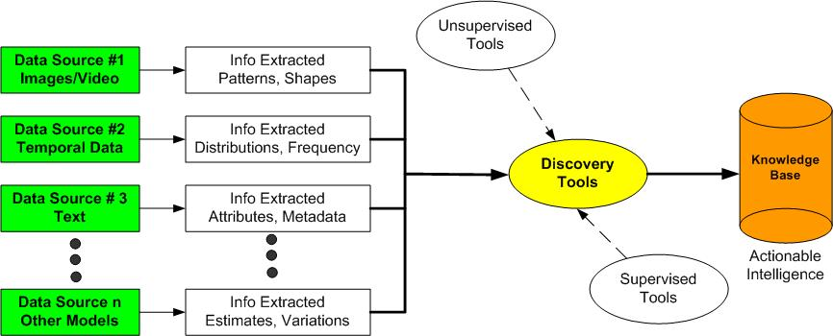
Goal: Transforming Data To Knowledge
Data – Information – Knowledge – Action/Decision
Realize that data is the only resource that humans have that the act of consumption creates more of the resource!!
Very Important!
Notes:
Note the Axiom in RED.
The important idea is that one analytic may not be enough to process the data properly. A set of analytics may be required to extract different pieces of information from one or more data sets.
This leads us to the problem of analytic architectures, which we will briefly address later.
It also leads to some very interesting questions:
What is/are the “right” analytics to process data set(s)?
Is/Are an analytic(s) better than others?
With multiple data sets and multiple analytics, how do we trace back from results to contributions from individual data sets?

Slide 22
Data Science
“Is a set of fundamental principles that guide the extraction of knowledge from data.”
(Provost & Fawcett, Data Science for Business)
Hal Varian, Mckinsey Quarterly, January 2009:
“The sexy job in the next ten years will be statisticians… The ability to take data—to be able to understand it, to process it, to extract value from it, to visualize it, to communicate it—that’s going to be a hugely important skill.”
http://www.mckinseyquarterly.com/Hal_Varian_on_how_the_Web_challenges_managers_2286
Maybe not sexy, but certainly lucrative, and challenging in many areas
Data scientists have advanced training in multivariate statistics, artificial intelligence, machine learning, mathematical programming, and simulation to perform
descriptive, estimative, and predictive analytics. And, often hold Ph.D.’s
Notes:
One definition of Data Science.
Most definitions focus on the use of statistical and numerical methods for the processing of big data.
My belief is that that is a start, but the non-statistical analytics are required.
Why?
Because there is no domain knowledge and understanding embedded in statistical approaches. Statistics begets more numbers, but the understanding comes from the humans who must interpret the resulting data.
When we discuss advanced analytics, I hope you will begin to see the difference.

Slide 23
Data Mining
“Is the computational process of discovering trends in data” (ACM)
A subset of Data Science
It incorporates statistical machine learning, statistics and database systems.
It is about extracting patterns and knowledge and identifying previously unknown relationships in the data.
Cluster analysis; anomaly detections; associations; relations
Used for hypothesis development and validation
Notes:
Data mining preceded data science by several years.
It seems these days, it is sometimes used synonymously with data science.
See the Wikipedia Article (which is pretty good)..

Slide 24
The Analytic Scientist
“The critical job in the next 20 years will be the analytic scientist … the individual with the ability to understand a problem domain, to understand and know what data to collect about it, to identify and develop analytics to process that data/information, to discover its meaning, and to extract knowledge from it—that’s going to be a very critical skill.”
- Kaisler, Armour, Espinosa, Money (2014) Amended
Analytic scientists require advanced training in specific domains, data science tools, multiple analytics, and visualization to perform predictive and prescriptive analytics.
Note: This is Increasingly Important For Complex Problems
Notes:
My colleagues and I believe that the more important role will be the person who can create new analytics in response to new and emerging complex problems.
I think the Analytic Scientist almost has to be a “Renaissance Person” – a multidimensional individual.
Will Graduate School make you this?
NO! As you gain experience and continue to study techniques, some of you may eventually evolve into this role.
Right now, there are MS Programs (even a few Ph.D. programs in Data Science), but none in Analytic Science!
I don’t believe that we will even begin to automate this capability in the next fifty years.
When a distinguished but elderly scientist states that something is possible, he is almost certainly right. When he states that something is impossible, he is very probably wrong.
Arthur C. Clarke

Slide 25
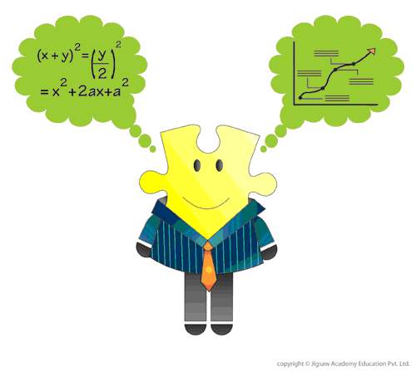
Role of the Analytic Scientist
Today’s complex problems require more than a single analytic.
The analytic scientist must also be a software and data architect.
Analysis is a process of continuous discovery – not only of knowledge but of new analytics.
They may hold Ph.D.’s, but pragmatic experience in a domain will be equally important.
Notes:
I see the Analytic Scientist as the Project Director who decides (with his staff) how to accomplish the steps in the Analytical Pipeline. And, who creates new analytics and tools and methods for using tools, as necessary.
Then, Data Scientists apply the tools at each of the phases of the Pipeline.
Some disagree with this view, but having been a Program Manager in several jobs, I have formulated this view over many years.

Slide 26
Big Data Issues Affecting Analytics
Volume:
How much data is really relevant to the problem solution? Cost of processing?
So, can you really afford to store and process all that data?
Velocity:
Much data coming in at high speed
Need for streaming versus block approach to data analysis
So, how to analyze data in-flight and combine with data at-rest
Variety:
A small fraction is structured formats, Relational, XML, etc.
A fair amount is semi-structured, as web logs, etc.
The rest of the data is unstructured text, photographs, etc.
So, no single data model can currently handle the diversity
Veracity: cover term for …
Accuracy, Precision, Reliability, Integrity, Provenance, Governance
So, what is it that you don’t know you don’t know about the data?
Value:
How much value is created for each unit of data (whatever it is)?
So, what is the contribution of subsets of the data to the problem solution?
Notes:
See our 2014 Paper in Technical Papers on Blackboard.
It has not been cited over 1000+ times in other articles and papers.
These are key questions regarding Big Data.

Slide 27
Challenges for Big Data Analytics
Axiom: Big Data is not just about the size or speed of your data – but, the complexity and quality.
Hypothesis: With more data to analyze, Big Data improves decision-making.
Conjecture: More data beats better algorithms, or does it?
Corollary: Big Data with simple algorithms will outperform sampled data with complex algorithms?
Problem: Many problems require an analytics capability beyond what is offered by traditional business analytics
Problem: Given a problem (the range), how do we identify the domains of data and the analytic(s) that will enable us to solve the problem?
Hypothesis: Can good algorithms, models, heuristics make up for data of poor quality? (Our answer: NO!!)
Notes:
Lots of challenges – more in the 2013 Paper
Lots of good topics to address – pick one – from that paper!
Also, from the Advanced Analytics papers!
…………..
If you have lost of the same data, lacking diversity does not open up new vistas in the problem.
This means that you reach a plateau of understanding of the problem, but – I think – can go no further.
What does diversity in data mean?
Last Hypothesis:
This is sometimes cited by bloggers, but is a fallacious assumption (in my opinion).

Slide 28
Types of Analytics
Descriptive: A set of techniques for reviewing and examining the data set(s) to understand the data and analyze business performance.
Diagnostic: A set of techniques for determine what has happened and why
Predictive: A set of techniques that analyze current and historical data to determine what is most likely to (not) happen
Prescriptive: A set of techniques for computationally developing and analyzing alternatives that can become courses of action – either tactical or strategic – that may discover the unexpected
Decisive: A set of techniques for visualizing information and recommending courses of action to facilitate human decision-making.
Passive
Active
Deductive
Descriptive
Diagnostic
Inductive
Predictive
Prescriptive
Decisive
Notes:
Our view of types of analytics.
Other authors have different/more or less categories.

Slide 29
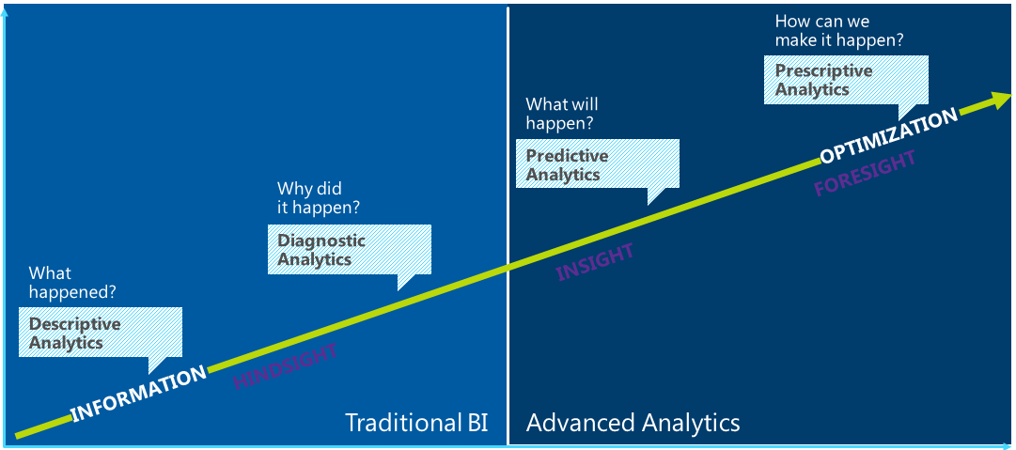
Analytics Road Map
Value Provided
Difficulty of Implementation, Use, Interpretation, …
Source: Gartner
Notes:
A graphic visualization of the previous slide’s categories.
We know how to do descriptive and diagnostic analytics very well.
This does not mean, however, that these are solved problems!
There are always new problems that require new analytics.
And, we know how to develop, integrate, assemble, etc. different analytics to form pipelines for description and diagnostics.
Where the going gets tough is developing good predictive analytics – that can yield meaningful, useful, and applicable predictions.
Even more difficult is developing prescriptive analytics to help you choose from among multiple predictions give different scenarios.
Predictions will vary from scenario to scenario given the boundary conditions and the initial data sets – even if the problem to be solved is the same.

Slide 30
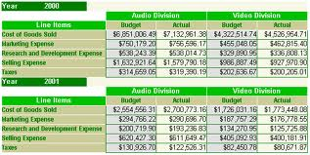
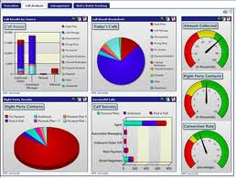
Descriptive Analytics
Process:
Identify the attributes, then assess/evaluate the attributes
Estimate the magnitude to correlate the relative contribution of each attribute to the final solution
Accumulate more instances of data from the data sources
If possible, perform the steps of evaluation, classification and categorization quickly
Yield a measure of adaptability within the Observe, Orient, Decide, Act (OODA) loop
At some threshold, crossover into diagnostic and predictive analytics
Notes:
With descriptive analytics, we are trying to explain what happened given the data at hand.
Descriptive analytics takes raw data and parses that data to draw conclusions that are useful and understandable by different users – managers, scientists, decision makers.
Analytic techniques often try to build models of some situation or look for patterns or trends in the data.
Preparing for descriptive analytics requires extraction of relevant data from the raw data set, transformation of the data – possibly to a canonical form, and loading the data into a repository, such as a data base.
Facts and figures are meaningless if you can’t gain valuable insights that lead to more-informed actions.

Slide 31
Descriptive Analytics
What has just happened?
Examine time series, evaluating past data to predict future demands (level, trend, seasonality):
Identify cyclical patterns
Isolate the impact of external events (such as, weather)
Characterize inherent variability
Detect trends.
Determine “causality” relationships between two or more time series:
As an example, forecast the demand for replacement parts for machinery at a manufacturing plant by considering both historical usage rates and known, predicted or seasonal changes in demand.
BlueFin Technologies → did viewers liked a particular TV show last night, based on Tweets?
Notes:
Often, you will see descriptive analytics focused on just one data set. For example, several papers for the HICSS Big Data minitrack have analyzed New York City Taxi trips over a several year period – a multigigarecord data set.
Diversity of data sources may give better insights into a particular phenomenon or situation.
But, to make the analysis tractable, you must transform the different data sets, usually with different representations, to a single canonical format.
Most often, statistical techniques are applied, but this does not have to be the case.
Other trans formations can be used – changing coordinates, changing scale, changing units of measure, changing structural information.

Slide 32

Descriptive Analytics
Identifying Patterns in data to determine what happened
Explaining those patterns by assessing flow across discrete temporal subsets of data
Source: http://xkcd.com/552/
Notes:
How do you determine causation from statistical analysis?
There are different types of correlation statistics. You may have to experiment with them to get the correlation you think is there.
But, there is both apparent correlation and real correlation. You need also to factor in bias. Sometimes, we see what we want to see and now what is there!

Slide 33
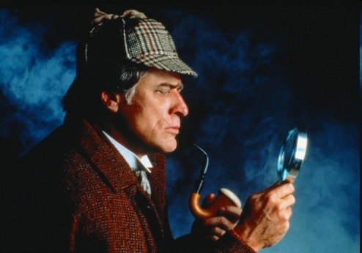
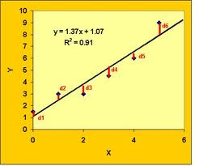
Diagnostic Analytics
Why did something happen?
Extract patterns from large data quantities via data mining
Correlate data types for explanation of near-term behavior – past and present
Estimate linear/non-linear behavior not easily identifiable through other approaches.
As an example, by classifying past insurance claims, estimate the number of future claims to flag for investigation with a high probability of being fraudulent.
Notes:
Diagnostic Analytics functions:
Identify anomalies: Based on the results of descriptive analysis, analysts must identify areas that require further study because they raise questions that cannot be answered simply by looking at the data. These could include questions like why sales have increased in a region where there was no change in marketing, or why there was a sudden change in traffic to a website without an obvious cause.
Drill into the analytics (discovery): Analysts must identify the data sources that will help them explain these anomalies. Often, this step requires analysts to look for patterns outside the existing data sets, and it might require pulling in data from external sources to identify correlations and determine if any of them are causal in nature.
Determine causal relationships: Hidden relationships are uncovered by looking at events that might have resulted in the identified anomalies. Probability theory, regression analysis, filtering, and time-series data analytics can all be useful for uncovering hidden stories in the data.
IDC predicts that by 2021, 25% of large enterprises will have supplemented data scientists with data ethnographers to provide contextual interpretations of data by using qualitative research methods that uncover people’s emotions, stories, and perceptions of their world.

Slide 34

Uses of Big Data: Starbucks
Starbucks talked to its baristas about how customers ordered coffee, lattes, and tea
Concern over the taste of a new coffee product
Social media was followed
Taste was fine but price was too high
Price was reduced by mid afternoon
Used data to design K-cups and several new teas – Pumpkin Spice, Peachy Black, and Mango Green Iced Tea
90M transactions/week in 25K stores
New app recommends coffees and teas based on customer history
Notes:
Starbucks uses a smart system called Atlas, developed by a location-analytics company called Esri. This data driven approach takes into account features like population density, average incomes, and traffic patterns to estimate the profitability and economic viability of the new store. Also, it predicts impact to already existing Starbucks in the area — compete with competitors and don’t bring your own brand down.
Starbucks launched a rewards program and a mobile app so that they could get “users in and data out”.
Data collected via the reward programs (more than 13 million active users) and the mobile app (more than 17 million active users) allows the coffee giant to learn about exact user behaviors — “Do you like to indulge more on a rainy day? Do you like muffins over croissants with your pumpkin flavored tea? Do you order a different type of coffee on workdays than on the weekend?”

Slide 35
Predictive Analytics
Predictive analytics utilizes a variety of statistical, modeling, data mining, and “machine learning” techniques to study recent and historical data, thereby allowing analysts to make predictions about the future.
"The purpose of predictive analytics is NOT to tell you what will happen in the future. It cannot do that. In fact, no analytics can do that. Predictive analytics can only forecast what might happen in the future, because all predictive analytics are probabilistic in nature.“
- Michael Wu, Lithium Technologies
Predictive analytics doesn't predict one possible future, but rather "multiple futures“.
Each prediction may be associated with a likelihood of occurrence.
But, the highest likelihood may not be the best rational for what to do next.
Notes:
Predictive analytics provides a predictive score (probability) for each individual (customer, employee, healthcare patient, product SKU, vehicle, component, machine, or other organizational unit) in order to determine, inform, or influence organizational processes that pertain across large numbers of individuals, such as in marketing, credit risk assessment, fraud detection, manufacturing, healthcare, and government operations including law enforcement.
Nearly any statistical model can be used for prediction purposes.
Broadly speaking, there are two classes of predictive models: parametric and non-parametric.
Parametric models make "specific assumptions with regard to one or more of the population parameters that characterize the underlying distribution(s)“.
Non-parametric models "typically involve fewer assumptions of structure and distributional form [than parametric models] but usually contain strong assumptions about independencies".
Axiom: Predictive ability is only as good as the data available!
Axiom: Bad data can yield bad predictions!

Slide 36
Predictive Analytics
What could happen next?
Extrapolate through different tools and techniques to long-term view
Choosing the right data to include in models is important.
Predictive analytics should not be searching for a diamond in a coal mine. You will get too many spurious findings.
Rather, it is important have some thoughts as to what variables might be related.
And once you have findings, domain knowledge is necessary to understand how they can be used.
Notes:
Examples:
Archaeology re: management of cultural sites and analysis of data based on artifact distribution, age, etc.
Auto Insurance/Health Care/Customer Relations Management
Algorithmic Trading: Predictive modeling in trading is a modeling process wherein the probability of an outcome is predicted using a set of predictor variables. Predictive models can be built for different assets like stocks, futures, currencies, commodities etc. Predictive modeling is still extensively used by trading firms to devise strategies and trade. It utilizes mathematically advanced software to evaluate indicators on price, volume, open interest and other historical data, to discover repeatable patterns.
There have been notable failures in the Bond Market, in the great recession of 2008-2009, the housing market and other areas.

Slide 37
Uses of Big Data: Target
http://www.forbes.com/sites/kashmirhill/2012/02/16/how-target-figured-out-a-teen-girl-was-pregnant-before-her-father-did/
Target assigns every customer a guest ID tied to their credit card
Stores a history of everything they bought and any demographic info
Andrew Pole looked at historical data for all women signed up for Target’s baby registry
From Pole’s analysis, some key patterns emerged
For example, they noticed that women started buying larger quantities of unscented lotion around the second trimester
And, in the first 20 weeks, pregnant women loaded up on mineral supplements and large cotton balls, hand sanitizers and wash clothes
They identified about 25 products that predicted pregnancy and could do so within a narrow window
So, Target started sending out coupons for baby items
Which started arriving at this teen’s house and caused her father to wonder what was going on

Slide 38
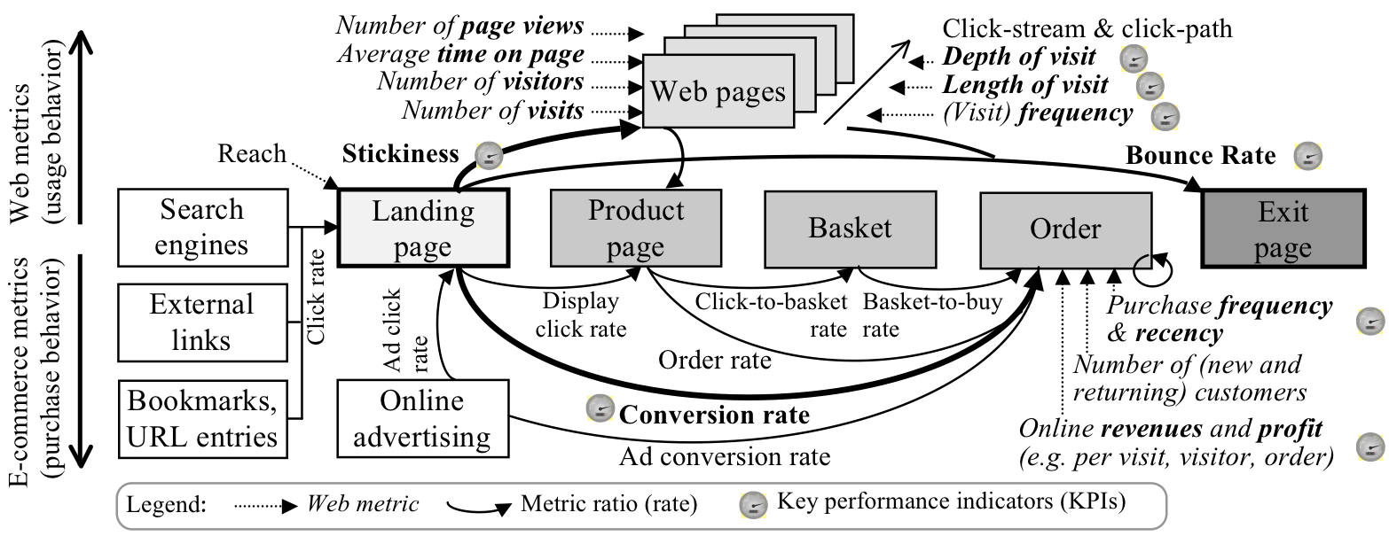
Another Example of Predictive Analytics
Notes:
PageRank (PR) is an algorithm used by Google Search to rank web pages in their search engine results. PageRank was named after Larry Page, one of the founders of Google. PageRank is a way of measuring the importance of website pages. According to Google:
PageRank works by counting the number and quality of links to a page to determine a rough estimate of how important the website is. The underlying assumption is that more important websites are likely to receive more links from other websites.
It is a link analysis algorithm and it assigns a numerical weighting to each element of a hyperlinked set of documents, such as the World Wide Web, with the purpose of "measuring" its relative importance within the set.
Currently, PageRank is not the only algorithm used by Google to order search results, but it is the first algorithm that was used by the company, and it is the best known.

Slide 39
Predictive Analytics Issues - I
There is very little data that is really predictive.
At best, using statistics, we can extrapolate from data using numerical methods, most of which is linear extrapolation.
“Figuring out what is truly causal and what is correlation is very difficult to do”.
Jan Hutzius, Chief Economist for Goldman Sachs
Axiom: Correlation does not imply Causation!
Just because two variables have a statistical relationship does not mean that one is responsible for the other.
Ice cream and forest fires are correlated because they both occur in the summer. You don’t light a patch of Montana brush on fire every time you buy a pint of Hagen Daz!
Targeting a particular variable in your analysis:
Remember the Hawthorne Effect (also Goldhart’s Law)!!
Notes:
Predictive analytics challenges:
Expertise is a challenge because predictive analytics solutions are typically designed for data scientists who have deep understanding of statistical modeling, R, and Python.
It’s not a secret that the more difficult a new technology is to use, the less likely end users are to adopt it—and predictive analytics solutions are notoriously difficult in meeting this challenge. This is because they typically live as standalone tools, which means users have to switch from their primary business application over to the predictive analytics solution in order to use it. What’s more, traditional predictive tools are hard to scale and deploy, which makes updating them a painful process.
No information is valuable in a vacuum. And that’s one of the reasons predictive analytics has fallen short in empowering end users. Often, predictive tools deliver information and insights, but they fail to let users take action.
Student Exercise: Can you think of other examples where correlation does not imply causation?

Slide 40
Predictive Analytics Issues - II
Many steps required:
Data preparation
Data cleansing
Identifying important columns
Recognizing correlations
Understanding how different algorithms (math) work
Choosing the right algorithm for the right problem
Deciding the right properties for the algorithm
Ensuring the data format is correct
Understanding the output of the algorithm run
Re-training the algorithm with new data
Dealing with imbalanced data
Deploying/re-deploying the model
Predicting in real time/batch
Integrating with your primary application to build data insights into the application and initiate user action (when embedding predictive)
Notes:
(Semi-) automated tools can help, but it is the expertise of the data scientist that yields the usable results.
Experience can help you to select the right tools more quickly.
There are some good term paper topics here.
Also, these are areas that require continuing research – good for Master’s Theses and Doctoral Dissertations.

Slide 41
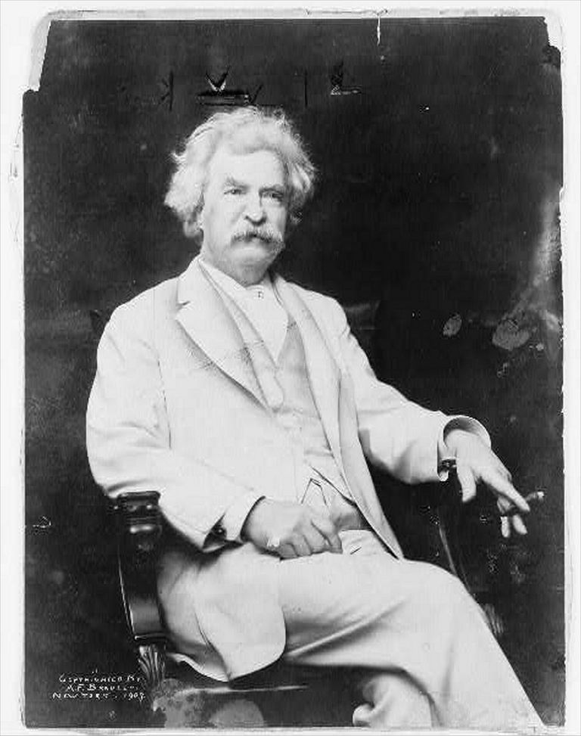
Predictive Analytics: Keep this in Mind!!
“Lies, damned lies, and statistics.” Mark Twain
Organizations are skeptical and suspicious of the statistician!
A phrase describing the persuasive power of numbers, particularly the use of statistics to bolster weak arguments.
Notes:
See the paper in the Technical Paper section of Outline!!
As Arthur Clarke once noted:
“One man’s or woman’s science is another’s magic!”

Slide 42
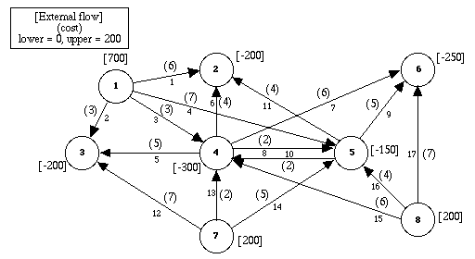

Prescriptive Analytics
What should happen next?
Determine what should occur and how to “make it so”
Determine the mitigating factors that lead to desirable/undesirable outcomes
“What-if” analysis w/ local or global optimization
Ex: Find the best set of prices and advertising to maximize revenue
And, the right set of moves to make to achieve that goal
“Make it so”
Notes:
There are many alternative futures just as there are many predictions that can arise from a predictive analysis.
The predictive results often depend on the parameters chosen for the analysis.
With prescriptive analytics were are looking for an “analysis of the analysis” – what is best course of action given the predictive results.
This is not as easy as it sounds. You just don’t pick the highest ranked alternative because in decision-making there are exogenous factors that can affect the decision.
In Predictive analytics, we cannot consider every factor. We try to find those that are most indicative of positive results for the phenomenon or situation we are studying.
We also need to know what it will take to make the prediction true, e.g., as Jean-Luc says “Make it so!”.

Slide 43
Visualization Analytics
Visual analytics: an evolving discipline which is driving new ways of presenting data and information to the user.
Visual analytics: “the science of analytical reasoning facilitated by interactive visual interfaces” (Thomas and Cook 2005)
Visual analytics:
the formation of visual metaphors in combination with a human information discourse (interaction)
enables detection of the expected and discovery of the unexpected within massive, dynamically changing information spaces. (Wong and Thomas 2004)
Visual analytics provides the “last 12 inches” between the masses of information and the human mind that enables us to make decisions.
It has been said: “A picture is worth a thousand words”
Ref: https://en.wikipedia.org/wiki/Visual_analytics
Notes:
We called this Decisive Analytics in an earlier slide because visualization can help us to see many alternatives.
Our brains are very good at processing information through our eyes.
One can think of reasoning as “meta analytics”. We apply analysis to the data to get usable and useful results.
But, then we apply a second layer of analysis to figuring out how to use the results to make decisions.
This two-layer approach would be a good subject for an MS Thesis or a PhD Dissertation.

Slide 44
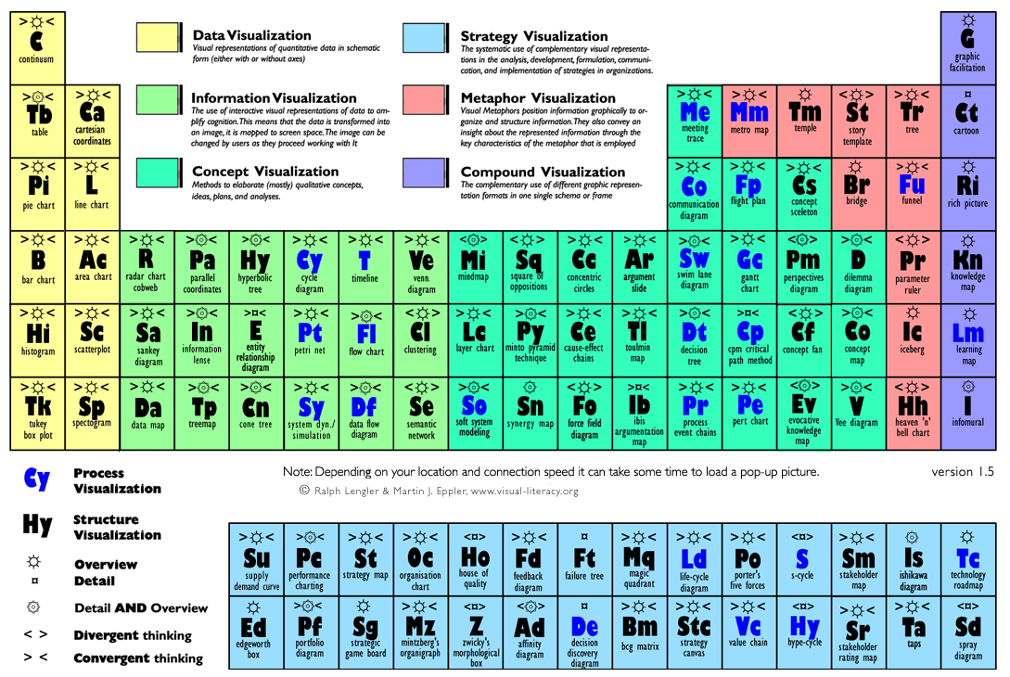
Visualization Analytics: A Periodic Table
Notes:
There are many visualization techniques.
Check out this web page. You can click on a cell to find something about that technique.
I already mentioned Edward Tufte’s books as well.
There are good topics here for a deeper dive into some of these techniques for a term paper.

Slide 45
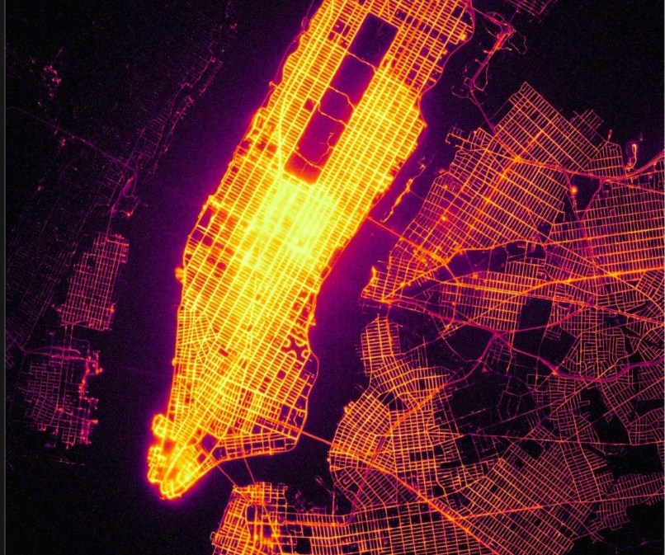
Visualization Example - I
1.3 Billion Taxi Rides
Data collected, cleaned and plotted the pick-up and drop-off locations of all taxi rides in New York between January 2009 and June 2016.
Notes:
Just an example of a very large data set.
Supposed you have to look at a paper printout of the data
(We used to do this for business data processing in the old days – before GUIs). We’d have stacks of line printer output that we would have to coam through to find the pertinent data we needed.

Slide 46
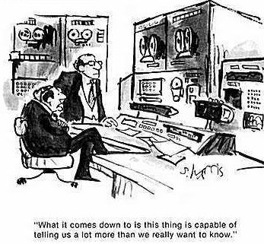
Decisive Analytics
Here is What we will do!
Given decision alternatives, choose the one course of action to do from possibly many
But, it may not be the optimal one.
Visualize alternatives – whole or partial subset
Perform exploratory analysis – what-if and why
How do I get to there from here?
How did I get here from there?
Notes:
Decisive analytics should try to help us decide what to do.
With Decisive Analytics, we need to be able to perform trade-offs among alternatives, and what-if reasoning.
Note: What appears to be optimal decision, may not be the best one given the context, the boundary conditions, and means to get there.
Herbert Simon from CMU, studied this problem extensively in Economics, and developed the concept of “satisficing”. It might be better – in the long run, in effort expended, in cost, or some other factors – to choose a satisfactory answer rather than strive for the optimal one.
For this work, He received the Memorial Nobel Prize in Economics.
I suspect that this should be largely AI-based (Symbolic AI).

Slide 47
The Role of Analytics
“Tools and techniques that gear the analyst’s mind to apply higher levels of critical thinking can substantially improve analysis… structuring information, challenging assumptions, and exploring alternative interpretations.”
Richards Heuer, Jr., The Psychology of Intelligence Analysis
Beware Frege’s Caution:
Converse Problems:
If you magnify on details, you are losing the overview
If you focus on the overview, you don’t see the details
Problem with Data Mining:
Applying statistics to understand the trends may cause a loss of problem understanding (forest vs. trees problem)
Problem with Statistical Machine Learning:
Changing the parameters, but not the decision processes and heuristics
Read about Gottlob Frege:https://en.wikipedia.org/wiki/Gottlob_Frege
Read about Gottlob Frege: https://plato.stanford.edu/entries/frege
Notes:
Heuer’s book is contained in the Reference Books section.
I suggest you all read it at some point.
I met Richards Heuer once when I was Senior Analyst at CIA. A most insightful and interesting person with a deep understanding of analysis.

Slide 48
The Analytics Continuum
Analytics problems span a continuum:
Short-term analysis leads to quick fixes and quick results, which may be unsustainable
What are the disruptive innovations in the middle-term that provide near-term domain leadership?
Long-term leads to strategic changes and innovations that provide sustainable domain dominance but take a long time to realize.
push
pull
Finding a Needle
In a Haystack
Top-Down Analysis
Deductive
A little bit of this; a little bit of that
Middle-Out Analysis
Abductive?
Spinning Straw into Gold
Bottom-Up Analysis
Inductive
Notes:
My colleagues and I think of analytics as spanning a continuum.
From the Deductive to the Inductive
In the middle is the Abductive model developed by Charles Pierce, an eminent American Philosopher and Logician.
See: https://en.wikipedia.org/wiki/Charles_Sanders_Peirce

Slide 49

Finding A Needle in a Haystack
With (all) the data available, find the/a key pattern that indicates a situational change
A single event
Perhaps, a sequence of events
Not the signal in the noise problem!! Where the level of noise overwhelms the signal.
Have we seen this pattern before?
Determine its characteristics, not just that it exists
Predict what event occurs next because this event occurred in the pattern
How to identify relevant fragments of data easily from a multitude of data sources?
Difficult to determine what the right answer is in advance
Problem: The needle hasn’t grown as fast as the haystack!!
Notes:
One aspect of the continuum is finding a key pattern that indicates a situational change. The pattern may be “once-off” or recurring. The former is much more difficult.
Not only do we want to detect it, we want to characterize it so we can recognize it (and any precursor events) if it should happen again.
[Think animals – cows, horses, sheep, dogs, etc. getting very antsy before an earthquake. Or, the birds miners use to carry in cages in coal mines to warn them of toxic gases.]
The whole subdiscipline of Indications & Warning, which we will mention in Advanced Analytics, is focused on this area.

Slide 50
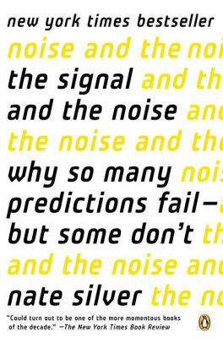
Signal and Noise
The practical art of mathematical model building using using probability and statistics as applied to real-world circumstances.
Silver decries: a belief in perfect experimental, survey, or other designs, when data often comes from a variety of sources and idealized modeling assumptions rarely hold true.
He believes in the need for extensive data sets, preferably collected over long periods of time, from which one can then use statistical techniques to incrementally change probabilities up or down relative to prior data.
Learning and understanding gained incrementally, rather than through any single set of observations or an ideal model summarized by just a few key parameters.
Notes:
Nate Silver has done a lot of analytics work over the years. Remember Moneyball?
See his website: https://fivethirtyeight.com/
This book is an excellent read. If you want to be a practicing data scientist, this book will provide you with a lot of insights.

Slide 51
Finding A Needle in a Haystack
What if the “needle” happens to be a complex data structure?
Brute force search and computation are unlikely to succeed due to inefficiency
Complexity increases with streaming data as opposed to a static data set
Axiom: Absence of evidence (so far) is not evidence of absence! (Borne 2013)
What preprocessing do we need to do before searching?
Quality vs. Quantity: What data are required to satisfy the given value proposition?
At what precision and accuracy and reliability and veracity
What if the needle must be derived rather than found?
How do we track the provenance of the derived data/information?
Is the process repeatable as we change algorithms and data structures?
What are the proxy variables that will be used in the derivation
Challenge: Consider finding the few packets in the trillions flowing through a network that carry a virus or malware.
Notes:
There are a number of challenges to this problem.
Complex data structures are much richer in description of an event, but may also be spread over a larger number of data elements. So, setting the “windows” for sequences of data elements may miss important data.
Sometimes the phenomenon is represented by proxy data, e.g., data representing the effect of the event rather than the event itself.
This often in particle physics where we see the decay products of a particle rather than the particle which may have a very short lifetime (on the order of 10⁻¹⁵ or so seconds).
Similarly for many chemical reactions although recent research and technology has been allowed us to see such reactions almost happening in real-time.
What if we have never seen the event before (but seen its effect)? How do we recognize the event working backwards from the effects?

Slide 52
Finding A Needle in a Haystack
What if the “needle” happens to be a complex data structure?
Brute force search and computation are unlikely to succeed due to inefficiency
Complexity increases with streaming data as opposed to a static data set
Absence of evidence (so far) is not evidence of absence! (Borne 2013)
What preprocessing do we need to do before searching?
Quality vs. Quantity: What data re required to satisfy the given value proposition?
At what precision and accuracy
What if the needle must be derived rather than found?
How do we track the provenance of the derived data/information?
Is the process repeatable as we change algorithms and data structures?
Challenge: Consider finding the few packets in the millions (er, billions) flowing through a network that carry a virus or malware.

Slide 53
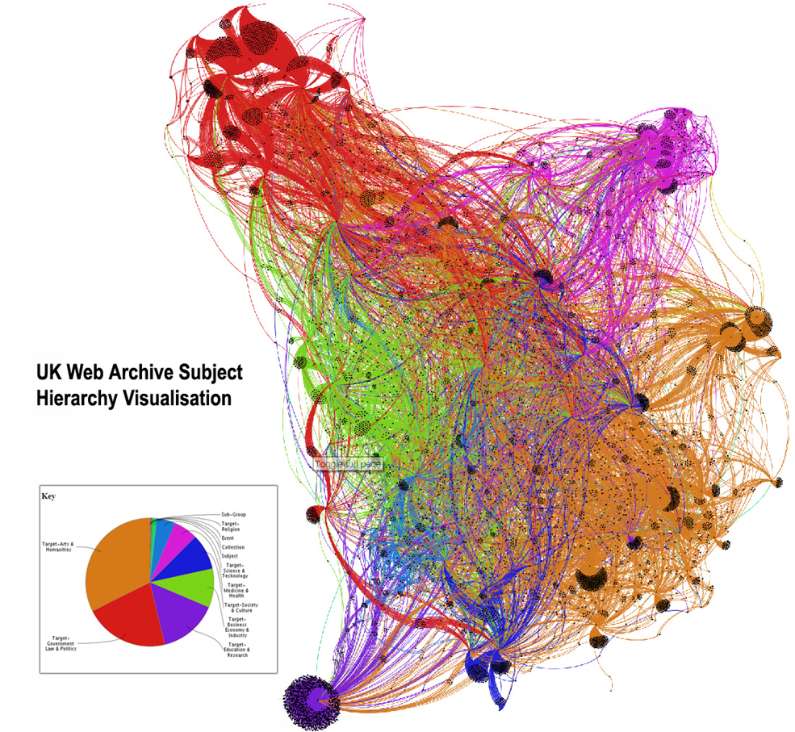
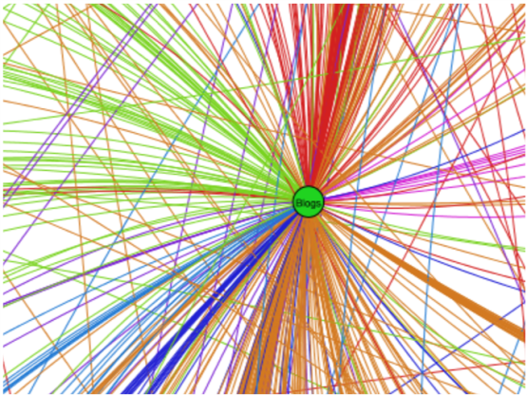
Needle(s) in a Haystack
Blogs
Ref: Crawford, L. Access and Analytics to the UK Archive, British Library, 2010
Uhmm! What are we supposed to glean from this picture?
Notes:
Just an example of a haystack. What are we looking for here?

Slide 54

Relevance to Big Data
We are drowning in the deluge of data that are being collected world-wide, while starving for knowledge at the same time*
Anomalous events occur relatively infrequently
However, when they do occur, their consequences can be quite dramatic and quite often in a negative sense
Ref: J. Naisbitt, Megatrends: Ten New Directions Transforming Our Lives. New York: Warner Books, 1982
“There’s a pony in here somewhere”
Notes:
Remember the story of the boy looking for a horse in the haystack.
Willie Sutton, noted bank robber, was asked why he robbed banks. He replied “that’s where the money is!”.
To paraphrase, why do we process large data sets, because that’s where the data is to solve our problem.
But, as discussed previously, there are many obstacle to finding the right data to process to solve the problem.

Slide 55

Spinning Straw Into Gold
With (all) the data available, describe a situation in a generalized form such that predictions for future events and prescriptions for courses of actions can be made.
Objective: Identify one or more patterns that characterize the behavior of the system.
Axiom: All data has value to someone, but not all data has value to everyone.
Patterns may be unknown or ambiguously defined.
Patterns may be morphing over time.
The problem is sensemaking: the dual process of trying to fit data to a model and of fitting a model around the data to explain it.
Neither data nor model comes first!
Must co-evolve concurrently!
Notes:
We defined this idea as one end of the analytics continuum.
Patterns are often difficult to find in large volumes of data if the amount of data comprising the pattern is small – say a few thousand bytes. Finding a few thousand bytes some number of times in billions/trillions of bytes is an intense computational task.
Moreover, connecting multiple instances of a pattern into a skein or network that represents some interesting phenomenon is also difficult.
If a pattern morphs, as for example, in the mutation of the Ebola virus or certain cancer cells, the computational complexity increases.
This is an interesting area for Doctoral research and could yield multiple dissertations. If we know the problem is morphing/evolving, how do we develop an approach to detect and track those changes and update our understanding of the problem.

Slide 56
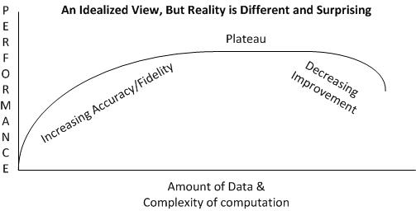
Finding the Knees
The knee of an algorithm or analytic is the scale value at which the performance begins to degrade as larger data volumes are processed.
Every analytic and algorithm has one (or more?)
Where positive slope increases begin to flatten out
Where positive or flat slopes transition to negative slopes
Factors affecting the knee:
data structure, volume, and variety
algorithm complexity, and
infrastructure implementation, including architecture.
What is/are the corollaries for non-algorithmic analytics?
Notes:
Every algorithm has a knee, which is dependent on:
The implementation of the algorithm, including its data structure
The computer architecture, including topology in multiprocessor configurations.
The amount of data it is to be applied to.
A lot of effort goes into finding where the “knee” is and improving the algorithm.
The knee often limits the deployability of an algorithm when attempting to process very large data sets.

Slide 57
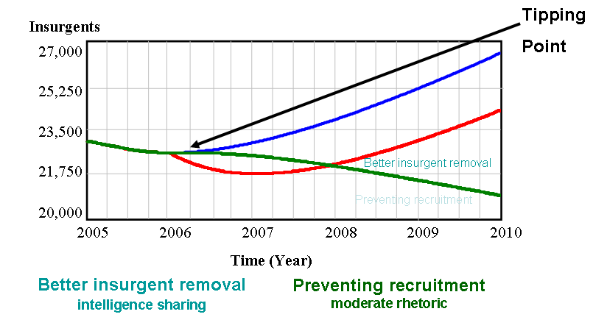
Finding the Tipping Point - I
A tipping point is one in which change in a system becomes potentially irreversible and maybe even unstoppable.
Maybe associated with negative or positive effects
In social systems, a buildup to a critical mass at which point a seminal change occurs.
Ex: MySpace was a formidable opponent of Facebook, but once the Facebook membership reached its “tipping point” people started abandoning MySpace and signing up for Facebook.
Small events can create ripple effects – may be linear or non-linear, chaotic or perturbative
Concept of emerging trends in the commercial marketplace
The explosion of a viral infection into an epidemic
Ref: Choucri, N., et al. (2006) Understanding and Modeling State stability: Exploiting System Dynamics. MIT Sloan Research Papers, No. 4574-06, Jan. 2006.
Notes:
Malcolm Gladwell’s book on Tipping Points examines this idea further.
It is difficult to recognize a tipping point until it is either upon us or has occurred with serious effects.
Consider a ball poised at the top of a hill. This is a “tipping point” because a slight breeze can send it down one side or the other. If one cannot predict when the “push” will come, we know the outcome but can predict when it will occur. But, in many real world situations, we don’t know the severity of the outcomes until they occur.
See this page for examples of tipping points that might cause severe effects in weather, society, animal populations, etc.
https://www.carbonbrief.org/explainer-nine-tipping-points-that-could-be-triggered-by-climate-change
This is a good term paper topic for deeper exploration.
Also, Doctoral Research to characterize and detect tipping points.

Slide 58
Finding the Tipping Point - II
Tipping Points occur in every field of endeavor:
Epidemiology, re: the spear of epidemics such the Great Flu of 1918, or Ebola virus in the late 20th Century
The recent meltdown in the Housing industry and collapse of the bond markets of 2008-2009.
The Diffusion Curve: how info/memes propagate through a social field
Tipping Point
Notes:
Note the tipping point can indicate either a great acceleration or a great deceleration of some physical phenomenon.

Slide 59
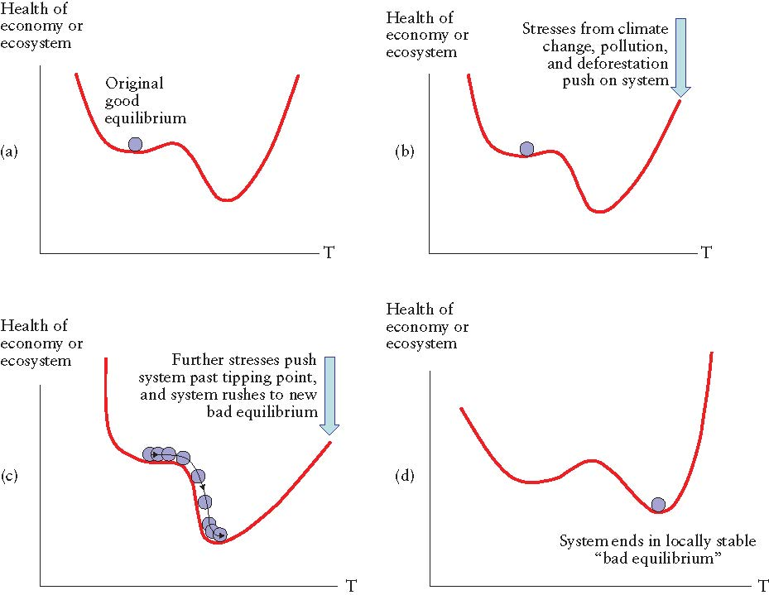
Finding the Tipping Point - III
Tipping points: moving from good to a bad equilibrium.
Stresses can change a system slowly until a tipping point is reached, after which there are rapid and potentially catastrophic changes. Note that there are two equilibria - a good equilibrium in (a), and a bad equilibrium in (d).
Notes:
Another example where a system moves through a series of tipping points to a level of lowest energy.
When electrons move to a lower orbit around a nucleus, they emit that energy as radiation. Sometimes, that is manifested as light.

Slide 60
Anomalies - I
An anomaly is a pattern in the data that does not conform to the expected behaviour
Behavior that occurs when it should not or is out of the ordinary
Behavior that does not occur when it should
(Sherlock Holmes, “The Hound of the Baskervilles”)
Also referred to as outliers, exceptions, peculiarities, surprise, etc.
Anomalies translate to significant (often critical) real life entities
Cyber intrusions
A web server involved in ftp traffic
Credit card fraud
An abnormally high purchase made on a credit card
Notes:
Anomalies are patterns of behavior that do not follow a norm of behavior that is often expected.
We will come back to his when we discuss Advanced Analytics.
But, consider the role of outliers in data. We will address this a bit in Lecture r when we discuss clustering and classification.
There are additional slides in the additional material at the end of the slide deck.
Here’s an example from “The Hound of the Baskervilles” – A Sherlock Holmes mystery:
A woman has been murdered in a house with other people around.
Why did the dog not bark in the night?

Slide 61
Anomalies - II
N₁ and N₂ are regions of normal behaviour
Examples of Point Anomalies:
Points O₁ and O₂ are anomalies
Points in region O₃ are anomalies
Anomalies are difficult to find using statistical techniques.
Rule-based systems often work very well
But, require explicit domain knowledge
How to Find?
K-Means Nearest Neighbour
Different clustering techniques
Activity vs time where sudden bursts occur
Y
N₁
o₁
O₃
o₂
N₂
X
Notes:
Outliers may be good or bad (or maybe just neutral):
A good outlier may indicate an anomaly that needs to be considered as a positive perturbation in behavior. It may indicate a change this beginning to occur in a system.
A bad outlier may be just a bad value – due to noise, instrumentation malfunction, a bad survey instrument, etc.
If it is neutral, it may not have any effect at all on the analysis.

Slide 62
Key Skills for Analytics Scientists
A high sense of intellectual curiousity
The need to know why and how
Mathematically and Logically oriented
Must be comfortable with mathematics and associated tools
Big Picture Vision:
Focus on the business decisions while dealing with the data
Q: What does it all mean?
Detail oriented:
Able to pay attention to the details no matter how mind-numbing they become
Able to differentiate between tools and methods
SAS, SPSS, Excel, etc. are “dumb” tools
Analytics is not SAS; it is using SAS to obtain results using analytical methods
Interpretation skills:
Numbers by themselves mean nothing
Expert and domain knowledge are required to interpret the results
Notes:
My thoughts on the characteristics of Analytic Scientists.

Slide 63
Training for Analytics Scientists (My View)
4 year college degree in Economics, Mathematics, Physics, Statistics, Ops Research, Decision Sciences, etc.
At least a Masters Degree in one of the above
Or, the new MS in Data Analytics
High proficiency in databases (e.g., NoSQL, MySQL) and query languages (e.g., SQL, Pig, etc.)
Knowledge of programming languages: Java, Javascript, Spark, Python, R, Scala, C/C++ (?)
Experience with domain analytics is a big plus (TBD)
Data modeling
Outstanding Excel and PowerPoint skills
Concise written and verbal communication
Good oral presentation skills
Ability to think creatively, analytically, and abstractly
Highly motivated and results-oriented
Notes:
OK. Don’t get scared. You don’t need to have all this before you graduate.
It would be nice, but you can build up this repertoire over the first few years of your career.

Slide 64
Making Decisions Based on models
“A model is a representation of a system that can be used to answer questions about the system”
“All decisions are based on models …and all models are wrong”
John Stearman, Eminent Statistician
“All models are wrong, but some are useful”
George Box, , Eminent Statistician
Axiom: It is better to be approximately right than to be absolutely wrong to infinite precision!
Notes:
Positive results are better than negative results.
Makes managers feel they understand the problem and its causes – even if they don’t.
Negative results don’t win Nobel Prizes.

Slide 65
References
Acharjya, D. P., S. Dehuri, and S. Sanyal, Eds. 2015. Computational Intelligence for Big Data Analysis. Springer Cham, Heidelberg, Germany
Ahlemeyer-Stubbe, A. and S. Coleman. 2014. A Practical Guide to Data Mining for Business and Industry, John Wiley & Sons, New York
Borne, K. 2013. Statistical Truiisms in the Age of Big Data, retrieved December 2013 from http://www.statisticsviews.com/details/feature/4911381/Statistical-Truisms-in-the-Age-of-Big-Data.html
Heuer, R.J., Jr. 1999. Psychology of Intelligence Analysis, Center for the Study of Intelligence, Central Intelligence Agency, Washington, D.C.
Myatt, G. J. and W. P. Johnson. 2014. Making Sense of Data I, 2nd Ed., John Wiley & Sons, New York
Provost, F. and T. Faucett. ?? Data Science for Business: What You Need to Know About Data Mining and Data-Analytic Thinking
Stanton, J. 2013. Introduction to Data Science, v3., Syracuse University, Syracuse, NY
Upton, G. J. G. 2017. Categorical Data Analysis By Example, John Wiley & Sons, New York
Nate Silver, fivethirtyeight.com ← Take a look!!

Slide 66
Class Projects
You will be programming in R, an object-oriented programming language with thousands of contributed packages.
Each project will use methods built into the R distribution as well as from various packages – most of which I will identify.
You will have to write some original R code
As upper level undergraduates/graduate students, you should be able to pick up the basics of R.
There are numerous books on R in Reference Books on Blackboard.
Notes:
There are three class projects addressing what I consider the “Big Three” areas of analytics.
(Note: I have no direct evidence, but have been doing analytics for over 40 years in various forms, so experience is my guide.)
For the most part, the projects emphasize using packages and methods within packages.

Slide 67
The R Environment
R is an integrated suite of software facilities for data manipulation, calculation and graphical display.
It includes:
an effective data handling and storage facility,
a suite of operators for calculations on arrays, in particular matrices,
a large, coherent, integrated collection of intermediate tools for data analysis,
graphical facilities for data analysis and display either on-screen or on hardcopy, and
a well-developed, simple and effective programming language which includes conditionals, loops, user-defined recursive functions and input and output facilities.
The term “environment” is intended to characterize it as a fully planned and coherent system, rather than an incremental accretion of very specific and inflexible tools, as is frequently the case with other data analysis software.
Notes:
See the additional notes on Introduction to Graph Analytics
In the old days, we use to program by command line.
The advent of Interactive Development Environments (IDEs) began in the mid-1970s with Smalltalk at Xerox PARC among other places.
I began, of course, with punched cards and batch processing, then interactive timesharing on an IBM 7094 and a UNIVAC 1108 at the University of Maryland, College Park.

Slide 68
R Packages
There are lots and lots of them!!
Avoid the ones that are no longer supported!
Probably those that have not been updated in the past two years
Explore the packages that are available
Make use of as many packages as you can; it will simplify your working the class projects
When downloading an R package, also download its .pdf file that describes how to use the package.
Notes:
When you search for R packages, you need to check the date of last update.
As R evolves, there are some evolutionary changes to the underlying infrastructure which render some earlier packages, if they have not been updated, unable to run in later versions.

Slide 69
RStudio
Download RStudio: http://www.rstudio.com/products/rstudio/
RStudio is an integrated development environment (IDE) for R.
It includes a console, syntax-highlighting editor that supports direct code execution, as well as tools for plotting, history, debugging and workspace management.

Slide 70
What You Should Do This Week
Download R and install it on your machine
Download Rstudio and install it on your machine
Read some of the manuals on one of the CRAN mirrors
Look at some of the R books on Blackboard
Play with R:
Run the demos
Try the Examples
Create some files of your own using a word processor
Learn to read text files and look at the R functions to see how to pick lines apart
Later This Week: I will tell you what is expected for the project.
I won’t tell you now because I want you to learn about R

Slide 71
Observations About R
R is a command line oriented program.
You will make a lot of typing mistakes.
Thus, use RStudio which provides a text editor
Use the First() function to configure your environment upon startup.
Use the initialization files:
Put in .Rprofile for local configuration or Rprofile for global configuration.
Setting/Getting working directory:
setwd(“g:\\SHKDir”);
getwd();

Slide 72
What You Should Do This Week
Download R and install it on your machine
Download Rstudio and install it on your machine
Read some of the manuals on one of the CRAN mirrors
Play with R:
Run the demos
Try the Examples
Create some files of your own using a word processor
Learn to read text files and look at the R functions to see how to pick lines apart
See the additional files on Blackboard
Try some of the graph packages
Lecture 2 will discuss graph analytics

Slide 73
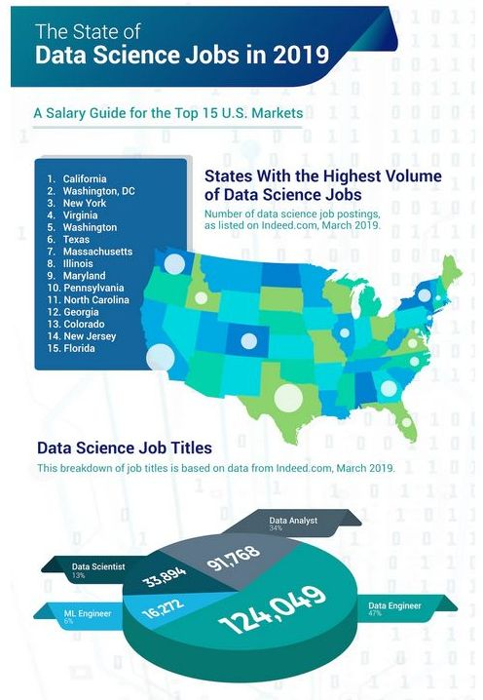
Why Data Science Might Be Important To You
Notes:
We’ll talk about some more statistics later.
Data Science continues to grow as career field. Its I largely focused on statistical analytic techniques.
In Lecture 3 we will talk about Analytic Science.

Slide 74
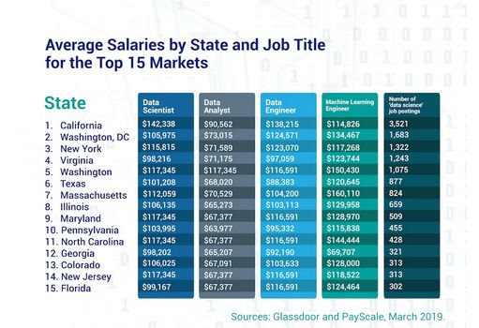
Why Data Science Might Be Important To You

Slide 75
Additional Material

Slide 76
References
Borne, K. 2013. Statistical truiisms in the Age of Big Data, retrieved December 2013 from http://www.statisticsviews.com/details/feature/4911381/Statistical-Truisms-in-the-Age-of-Big-Data.html
Heuer, R.J., Jr. 1999. Psychology of Intelligence Analysis, Center for the Study of Intelligence, Central Intelligence Agency, Washington, D.C.
Provost, F. and T. Faucett. ?? Data Science for Business: What You Need to Know About Data Mining and Data-Analytic Thinking
Stanton, J. 2013. Introduction to Data Science, v3., Syracuse University, Syracuse, NY

Slide 77
Ten Principles of Analytics
Visual + Interactive:
Be able to quickly view and manipulate data
Invoke tools as understanding evolves
Zero Code:
Tools should be designed for business or operations users
Require no programming (or even knowledge of it)
Tools should provide a lot of capabilities
Easy to Use (Actually!)
The interface must be understandable
GUIs are sometimes much harder to use than command lines if you don’t understand what is going to happen hen you click on something
Need to understand what it means when you type a value into a field
Develop tools for the least common denominator: Homer Simpson

Slide 78
Ten Principles of Analytics
Fast:
A relative term, but you will know it when you see it
Generally, results must be returned within the attention span of the user.
Cycle time versus response time
5. Disposable/Persistent:
Some analytics are performed only once; some may be repeated
Be able to conceive of and execute analysis quickly, and dispose of the results when no longer needed.
Collaborative:
Analysis is often a collaborative process, requiring results to be shared among a group of users
What may be important is to just the results, but the steps
to get there

Slide 79
Ten Principles of Analytics
Conceptually Sound:
Interactive analysis of data must be based on a sound set of relationships between the tools used to process the data
Hide the data models and storage requirements from the user
Depth:
User must be able to see, if necessary, all of the attributes of the data
User must be able to filter the data to obtain workable, usable subsets
Good Software Citizen
Analytics need to fit within the enterprise architecture
Observe security, integrity and so forth – be well-behaved
Expressive:
Moving from idea to visualization to action has to be simple

Slide 80
A Starter List - I
Understanding and Targeting Customers
One of the biggest and most publicized areas of big data use today.
Companies are keen to expand their traditional data sets with social media data, browser logs and text analytics and sensor data to get a more complete picture of their customers.
The objective – create predictive models of customer behavior.
Understanding and Optimizing Business Processes
Optimizing stock on hand based on purchase patterns, supply chains and delivery routes
Geographic positioning and radio frequency identification sensors are used to track goods or delivery vehicles and optimize routes by integrating live traffic data, etc.
Optimize talent acquisition – Moneyball style

Slide 81
A Starter List - II
Improving Healthcare and Public Health
Analysis of DNA and genome data will enable the detection of bases for diseases and predisposition to wards certain illnesses, etc.
Think about the impact on clinical trials with 100,000s of people wearing different types of monitors
Improving Sports Performance
Most elite sports have now embraced big data analytics.
Video analytics are used to track the performance of every player in a football or baseball game
Financial Trading:
In High-Frequency Trading (HFT), big data algorithms are used to make trading decisions that humans are unable to make.

Slide 82
A Starter List - III
Science and Research:
Too numerous to do justice to all of the applications.
CERN uses 65,000 processors to analyze the 30 PBytes of data it has collected from the Large Hadron Collider
Optimizing Machine and Device Performance:
The Toyota Prius is fitted with cameras, GPS as well as powerful computers and sensors to safely drive on the road without the intervention of human beings
Improving Security and Law Enforcement
Preventing terrorist and cyber attacks
Credit card companies use big data to predict fraud and crime

